Slide 1
Input / Output System Calls
Basically there are total 5 types of I/O system calls:
1. Create: Used to Create a new empty file.
Syntax in C language:
int creat(char *filename, mode_t mode)
Parameter :
filename : name of the file which you want to create
mode : indicates permissions of new file.
Returns :
return first unused file descriptor (generally 3 when first creat use in process beacuse 0, 1, 2 fd are reserved)
return -1 when error
How it work in OS
Create new empty file on disk
Create file table entry
Set first unused file descriptor to point to file table entry
Return file descriptor used, -1 upon failure

Slide 2
Input / Output System Calls
2. open: Used to Open the file for reading, writing or both.
Syntax in C language
#include <fcntl.h>
int open (const char* Path, int flags, [int mode ]);
Parameters
Path : path to file which you want to use
use absolute path begin with “/”, when you are not working in same directory of file.
Use relative path which is only file name with extension, when you are working in same directory of file.
flags : How you like to use
O_RDONLY: open for read only, O_WRONLY: write only, O_RDWR: read and write, O_CREAT: create file if it doesn’t exist,
How it works in OS
Find existing file on disk
Create file table entry
Set first unused file descriptor to point to file table entry
Return file descriptor used, -1 upon failure

Slide 3
Input / Output System Calls
// C program to illustrate // open system call #include<stdio.h> #include<fcntl.h> #include<errno.h> extern int errno; int main() { // if file does not have in directory // then file foo.txt is created. int fd = open("foo.txt", O_RDONLY | O_CREAT); printf("fd = %d/n", fd); if (fd ==-1) { // print which type of error have in a code printf("Error Number % d\n", errno); // print program detail "Success or failure" perror("Program"); } return 0; }
Output: fd = 3

Slide 4
Input / Output System Calls
3. close: Tells the operating system you are done with a file descriptor and Close the file which pointed by fd.
Syntax in C language
#include <fcntl.h>
int close(int fd);
Parameter
fd :file descriptor
Return
0 on success.
-1 on error.
How it works in the OS
Destroy file table entry referenced by element fd of file descriptor table – As long as no other process is pointing to it!
Set element fd of file descriptor table to NULL

Slide 5
Input / Output System Calls
// C program to illustrate close system Call #include<stdio.h> #include <fcntl.h> int main() { int fd1 = open("foo.txt", O_RDONLY); if (fd1 < 0) { perror("c1"); exit(1); } printf("opened the fd = % d\n", fd1); // Using close system Call if (close(fd1) < 0) { perror("c1"); exit(1); } printf("closed the fd.\n"); }
// C program to illustrate close system Call #include<stdio.h> #include<fcntl.h> int main() { // assume that foo.txt is already created int fd1 = open("foo.txt", O_RDONLY, 0); close(fd1); // assume that baz.txt is already created int fd2 = open("baz.txt", O_RDONLY, 0); printf("fd2 = % d\n", fd2); exit(0); }
Output:
fd2 = 3
Here, In this code first open() returns 3 because when main process created, then fd 0, 1, 2 are already taken by stdin, stdout and stderr. So first unused file descriptor is 3 in file descriptor table. After that in close() system call is free it this 3 file descriptor and then after set 3 file descriptor as null. So when we called second open(), then first unused fd is also 3. So, output of this program is 3.
Output:
opened the fd = 3
closed the fd.

Slide 6
Input / Output System Calls
4. read: From the file indicated by the file descriptor fd, the read() function reads cnt bytes of input into the memory area indicated by buf. A successful read() updates the access time for the file.
Syntax in C language
size_t read (int fd, void* buf, size_t cnt);
Parameters
fd: file descripter
buf: buffer to read data from
cnt: length of buffer
Returns: How many bytes were actually read
return Number of bytes read on success
return 0 on reaching end of file
return -1 on error
return -1 on signal interrupt
Important points
buf needs to point to a valid memory location with length not smaller than the specified size because of overflow.
fd should be a valid file descriptor returned from open() to perform read operation because if fd is NULL then read should generate error.
cnt is the requested number of bytes read, while the return value is the actual number of bytes read. Also, some times read system call should read less bytes than cnt.

Slide 7
Input / Output System Calls
// C program to illustrate // read system Call #include<stdio.h> #include <fcntl.h> int main() { int fd, sz; char *c = (char *) calloc(100, sizeof(char)); fd = open("foo.txt", O_RDONLY); if (fd < 0) { perror("r1"); exit(1); } sz = read(fd, c, 10); printf("called read(% d, c, 10). returned that %d bytes were read.\n", fd, sz); c[sz] = '\0'; printf("Those bytes are as follows: % s\n", c); }
Output:
called read(3, c, 10). returned that 10 bytes were read.
Those bytes are as follows: 0 0 0 foo

Slide 8
Input / Output System Calls
// C program to illustrate // read system Call #include<stdio.h> #include<fcntl.h> int main() { char c; int fd1 = Open("foobar.txt", O_RDONLY, 0); int fd2 = Open("foobar.txt", O_RDONLY, 0); Read(fd1, &c, 1); Read(fd2, &c, 1); printf("c = % c\n", c); exit(0); }
Output:
c = f
The descriptors fd1 and fd2 each have their own open file table entry, so each descriptor has its own file position for foobar.txt. Thus, the read from fd2 reads the first byte of foobar.txt, and the output is c = f, not c = o.

Slide 9
Input / Output System Calls
5. write: Writes cnt bytes from buf to the file associated with fd. If cnt is zero, write() simply returns 0 without attempting any other action.
#include <fcntl.h>
size_t write (int fd, void* buf, size_t cnt);
Parameters
fd: file descripter
buf: buffer to write data to
cnt: length of buffer
Returns: How many bytes were actually written
return Number of bytes written on success
return 0 on reaching end of file
return -1 on error
return -1 on signal interrupt
Important points
The file needs to be opened for write operations
buf needs to be at least as long as specified by cnt because if buf size less than the cnt then buf will lead to the overflow condition.
cnt is the requested number of bytes to write, while the return value is the actual number of bytes written. This happens when fd have a less number of bytes to write than cnt.
If write() is interrupted by a signal, the effect is one of the following: -If write() has not written any data yet, it returns -1 and sets errno to EINTR. -If write() has successfully written some data, it returns the number of bytes it wrote before it was interrupted.

Slide 10
Input / Output System Calls
Output:
called write(3, "hello geeks\n", 12). it returned 11
Here, when you see in the file foo.txt after running the code, you get a “hello geeks“. If foo.txt file already have some content in it then write system call overwrite the content and all previous content are deleted and only “hello geeks” content will have in the file.
// C program to illustrate // write system Call #include<stdio.h> #include <fcntl.h> main() { int sz; int fd = open("foo.txt", O_WRONLY | O_CREAT , 0644); if (fd < 0) { perror("r1"); exit(1); } sz = write(fd, "hello geeks\n", strlen("hello geeks\n")); printf("called write(% d, \"hello geeks\\n\", %d)." " It returned %d\n", fd, strlen("hello geeks\n"), sz); close(fd); }

Slide 11
Print “hello world” from the program without use any printf or cout function.
// C program to illustrate // I/O system Calls #include<stdio.h> #include<fcntl.h> int main (void) { int fd[2]; char buf1[12] = "hello world"; char buf2[12]; // assume foobar.txt is already created fd[0] = open("foobar.txt", O_RDWR); fd[1] = open("foobar.txt", O_RDWR); write(fd[0], buf1, strlen(buf1)); write(1, buf2, read(fd[1], buf2, 12)); close(fd[0]); close(fd[1]); return 0; }
Output:
hello world

Slide 12
Dup System Call
The dup() system call creates a copy of a file descriptor.
It uses the lowest-numbered unused descriptor for the new descriptor.
If the copy is successfully created, then the original and copy file descriptors may be used interchangeably.
int dup(int oldfd);
oldfd: old file descriptor whose copy is to be created.

Slide 13
Dup System Call
// CPP program to illustrate dup()
#include<stdio.h>
#include <unistd.h>
#include <fcntl.h>
int main()
{
// open() returns a file descriptor file_desc to a
// the file "dup.txt" here"
int file_desc = open("dup.txt", O_WRONLY | O_APPEND);
if(file_desc < 0)
printf("Error opening the file\n");
// dup() will create the copy of file_desc as the copy_desc
// then both can be used interchangeably.
int copy_desc = dup(file_desc);
// write() will write the given string into the file
// referred by the file descriptors
write(copy_desc,"This will be output to the file named dup.txt\n", 46);
write(file_desc,"This will also be output to the file named dup.txt\n", 51);
return 0;
}

Slide 14
Dup2 System Call
The dup2() system call is similar to dup() but the basic difference between them is that instead of using the lowest-numbered unused file descriptor, it uses the descriptor number specified by the user.
int dup2(int oldfd, int newfd);
oldfd: old file descriptor
newfd new file descriptor which is used by dup2() to create a copy.
Include the header file unistd.h for using dup() and dup2() system call.
If the descriptor newfd was previously open, it is silently closed before being reused.
If oldfd is not a valid file descriptor, then the call fails, and newfd is not closed.
If oldfd is a valid file descriptor, and newfd has the same value as oldfd, then dup2() does nothing, and returns newfd.

Slide 15
Dup2 System Call
// CPP program to illustrate dup2()
#include<stdlib.h>
#include<unistd.h>
#include<stdio.h>
#include<fcntl.h>
int main()
{
int file_desc = open("tricky.txt",O_WRONLY | O_APPEND);
// here the newfd is the file descriptor of stdout (i.e. 1)
dup2(file_desc, 1) ;
// All the printf statements will be written in the file
// "tricky.txt"
printf("I will be printed in the file tricky.txt\n");
return 0;
}

Slide 16
File Descripter
A file descriptor is a number that uniquely identifies an open file in a computer's operating system. It describes a data resource, and how that resource may be accessed.
To the kernel all open files are referred to by file descriptors – non negative integers.
When we open an existing file or create a new file, the kernel returns a file descriptor to the process.
When we want to read or write a file, we identify the file with the file descriptor.
The descriptor is identified by a unique non-negative integer, such as 0, 12, or 567. At least one file descriptor exists for every open file on the system.
When a process makes a successful request to open a file, the kernel returns a file descriptor which points to an entry in the kernel's global file table. The file table entry contains information such as the inode of the file, byte offset, and the access restrictions for that data stream (read-only, write-only, etc.).

Slide 17
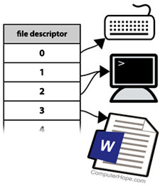
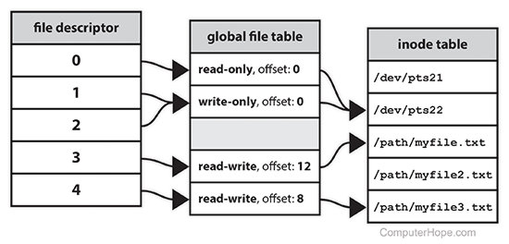
File Descripter

Slide 18
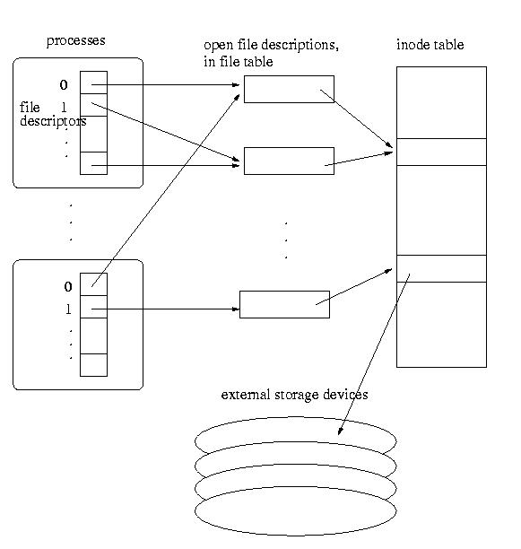
File Descripter
File descriptor: A per-process, unique, nonnegative integer used to identify an open file for the purposes of file access
File table : It contains information that is global to the kernel e.g. the byte offset in the file where the user's next read/write will start and the access rights allowed to the opening process.
Open file description: A record of how a process or group of processes are currently accessing a file
Each file descriptor refers to exactly one open file description, but an open file description may be referred to by more than one file descriptor
A file offset and file access modes are attributes of an open file description
File access modes: Specification of whether the file can be read or written
File offset: The byte position in the file where the next I/O operation through that open file description begins
Inode : Its a complex data-structure that contains all the necessary information to specify a file. It includes the memory layout of the file on disk, file permissions, access time, number of different links to the file etc.

Slide 19
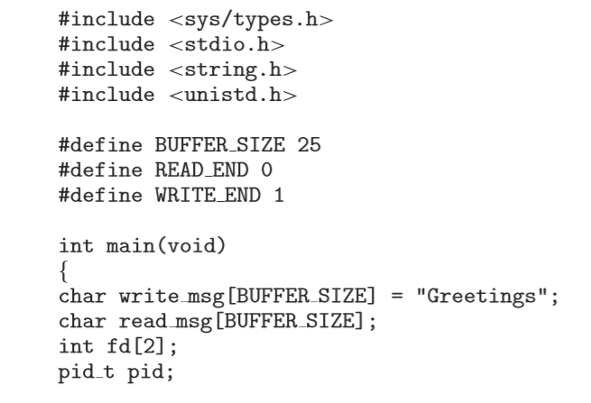
Ordinary Pipes

Slide 20
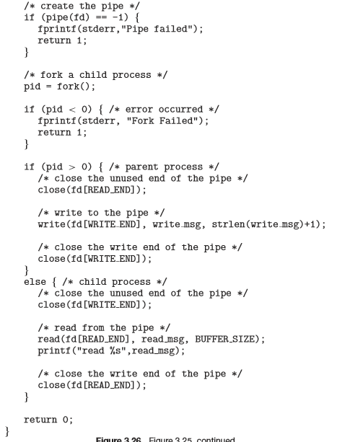
Ordinary Pipes

Slide 21
Implementation of ls | wc using pipe
#include<stdlib.h> #include<unistd.h> #include<stdio.h> #include<fcntl.h>
void main()
{
int fd[2];
pipe(fd); /*Called pipe, pipe system call will return two file descripter fd[0] for read end and fd[1] for write end of the pipe*/
int id = fork(); //fork system call creates a child process
if(id==0)//child process
{
close(1); //Close stdout
dup(fd[1]); //duplicate fd[1] to stdout
close(fd[1]); //close Child process write end file descripter fd[1]
close(fd[0]); //close Child process read end file descripter fd[0]
execlp(“ls",“ls",NULL); //ls system call will execute
}
else if(id>=0)//Parent Process
{
close(fd[1]); //close Child process write end file descripter fd[1]
close(0); //close stdin
dup(fd[0]); //duplicate fd[1] to stdin
close(fd[0]); //close Child process read end file descripter fd[0]
execlp("wc","wc",NULL); //wc system call will execute
}
else { printf("Fork Failed");//fork failed } }

Slide 22
Implementation of who | wc using pipe
#include<stdlib.h> #include<unistd.h> #include<stdio.h> #include<fcntl.h>
void main()
{
int fd[2];
pipe(fd); /*Called pipe, pipe system call will return two file descripter fd[0] for read end and fd[1] for write end of the pipe*/
int id = fork(); //fork system call creates a child process
if(id==0)//child process
{
close(1); //Close stdout
dup(fd[1]); //duplicate fd[1] to stdout
close(fd[1]); //close Child process write end file descripter fd[1]
close(fd[0]); //close Child process read end file descripter fd[0]
execlp("who","who",NULL); //who system call will execute
}
else if(id>=0)//Parent Process
{
close(fd[1]); //close Child process write end file descripter fd[1]
close(0); //close stdin
dup(fd[0]); //duplicate fd[1] to stdin
close(fd[0]); //close Child process read end file descripter fd[0]
execlp("wc","wc",NULL); //wc system call will execute
}
else { printf("Fork Failed");//fork failed } }

Slide 23
C Program to print “Hello” using pipe
#include<stdlib.h>
#include<unistd.h>
#include<stdio.h>
#include<fcntl.h>
void main()
{
char buff[1024];
int fd[2],n;
pipe(fd); /*Called pipe, pipe system call will return two file descripter fd[0] for read end and fd[1] for write end of the pipe*/
int id = fork(); //fork system call creates a child process
if(id==0)//child process
{
close(fd[0]);
write(fd[1],"HELLO",5);
}
else if(id>=0)//Parent Process
{
close(fd[1]);
read(fd[0], buff,5);
write(1,buff,5);
}
else { printf("Fork Failed");//fork failed
} }

Slide 24
C Program to print user I/P on Screen using pipe
#include<stdlib.h>
#include<unistd.h>
#include<stdio.h>
#include<fcntl.h>
void main()
{
char buff[1024];
int fd[2],n;
pipe(fd); /*Called pipe, pipe system call will return two file descripter fd[0] for read end and fd[1] for write end of the pipe*/
int id = fork(); //fork system call creates a child process
if(id==0)//child process
{
close(fd[0]);
while((n=read(0,buff,n))>0)
write(fd[1],buff,n);
}
else if(id>=0)//Parent Process
{
close(fd[1]);
while((n=read(fd[0],buff,n))>0)
write(1,buff,n);
}
else { printf("Fork Failed");//fork failed } }

Slide 25
C Program to redirect output of ls | wc to a file using pipe
#include<stdlib.h>
#include<unistd.h>
#include<stdio.h>
#include<fcntl.h>
void main()
{
int fd[2],fdt1;
pipe(fd);
int id = fork();
if(id==0)
{
close(1);
dup(fd[1]);
close(fd[1]);
close(fd[0]);
execlp("ls","ls",NULL);
}
else if(id>0)
{
fdt1=open("output.txt",O_WRONLY);
close(1);
dup(fdt1);
close(fdt1);
close(fd[1]);
close(0);
dup(fd[0]);
close(fd[0]);
execlp("wc","wc",NULL);
}
else{}}

Slide 26
Named Pipes
Named Pipes are more powerful than ordinary pipes
Communication is bidirectional
No parent-child relationship is necessary between the communicating processes
Several processes can use the named pipe for communication
Provided on both UNIX and Windows systems

Slide 27
End of Chapter 3

